Slide 1

Database Recovery: Backup and Dumping
Presented by: Salim Shrestha, Saraswoti Rokaya & Surya yadav
Based on Chapter 10 – Recovery Section

Slide 2
Outline
Introduction
Database Backup
Types of Database Backup
Backup Techniques
Introduction to dumping
What is a dump file?
Importance of Dumping
Basic Example (Using phpMyAdmin -Web Interface)
Basic Example (MySQL)
Restoring the Database
Thank You / Conclusion

Slide 3
What is Database Backup?
Creating a copy of data to protect it from loss or system failure.
Purpose: Safeguard data from hardware/software failure and recover after disasters.
Managed by: Database Administrator (DBA).
Stored in: Magnetic tapes, Hard disks, Flash drives, Remote servers.

Slide 4
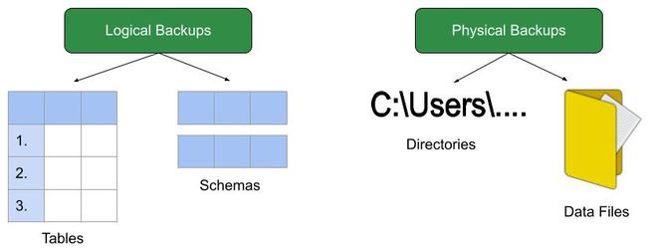
Types of Database Backup
Physical Backup: Copies actual physical files (datafiles, control files, redo logs).
Provides detailed transaction info and is foundation for recovery.
Logical Backup: Extracts logical data (tables, views, procedures, functions).
Useful for restoring specific database objects.

Slide 5
Backup Techniques
Full Database Backup: Complete copy of the database including all data and transactions.
Differential Backup: Copies only changes since the last full backup; smaller and faster.
Transaction Log Backup: Saves only transaction logs; keeps backup small and efficient.

Slide 6
Introduction to Dumping
Dumping in databases means copying or exporting the entire database (or part of it).
The copied data is saved into a dump file for:
Backup
Transfer
Recovery
It’s an important part of database recovery and helps restore data if the system fails.

Slide 7
What is a Dump File?
A dump file contains:
SQL commands
Table structures
Data records
Database schema
Purpose: To recreate the database if it is lost, damaged, or needs to be moved.

Slide 8
Importance of Dumping
Protects against data loss
Makes database transfer easier
Helps restore after corruption or crash
Used by developers, DBAs, and backup systems
Ensures data safety and system reliability

Slide 9
Basic Example (Using phpMyAdmin -Web Interface)
Start the Apache and MySQL services in your XAMPP Control Panel.
Open your web browser and navigate to http://localhost/phpmyadmin.
Select the specific database you want to dump from the list on the left sidebar.
Click on the "Export" tab in the top navigation bar.
On the export page, select the "Quick" export method (or "Custom" for more options) and ensure the format is set to "SQL".
Click the "Go" button to start the download of the .sql file.

Slide 10
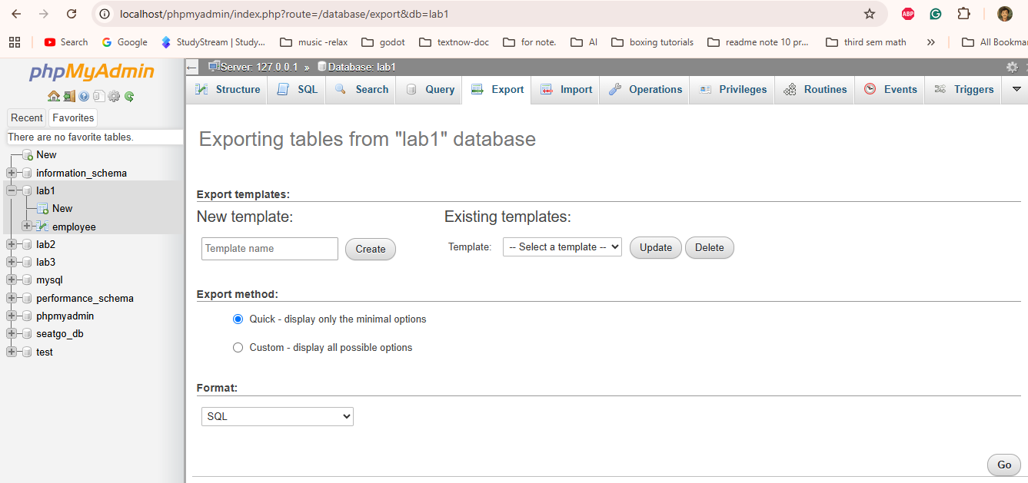
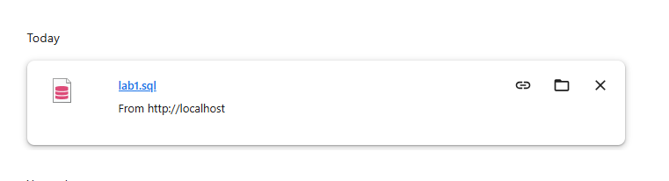
Basic Example (Using phpMyAdmin -Web Interface)

Slide 11
Basic Example (Using Command MySQL)
Suppose database name is school_db
To dump (export) the data:
mysqldump -u root -p school_db > school_backup.sql
Explanation:
mysqldump → tool used for dumping
school_db → database name
school_backup.sql → dump file storing SQL commands

Slide 12
Restoring the Database (phMyAdmin Interface)
Open phpMyAdmin: Access http://localhost/phpmyadmin in your browser.
Create a New Database:
Go to the Import Tab: Select the newly created, empty database from the left pane, then click the "Import" tab in the top navigation bar.
Select the SQL File: Click the "Browse..." or "Choose File" button and select the .sql backup file you saved earlier.
Start Import: Scroll down and click "Go" to start the import process. Once complete, you will see a success message and the tables will appear in the left pane.

Slide 13
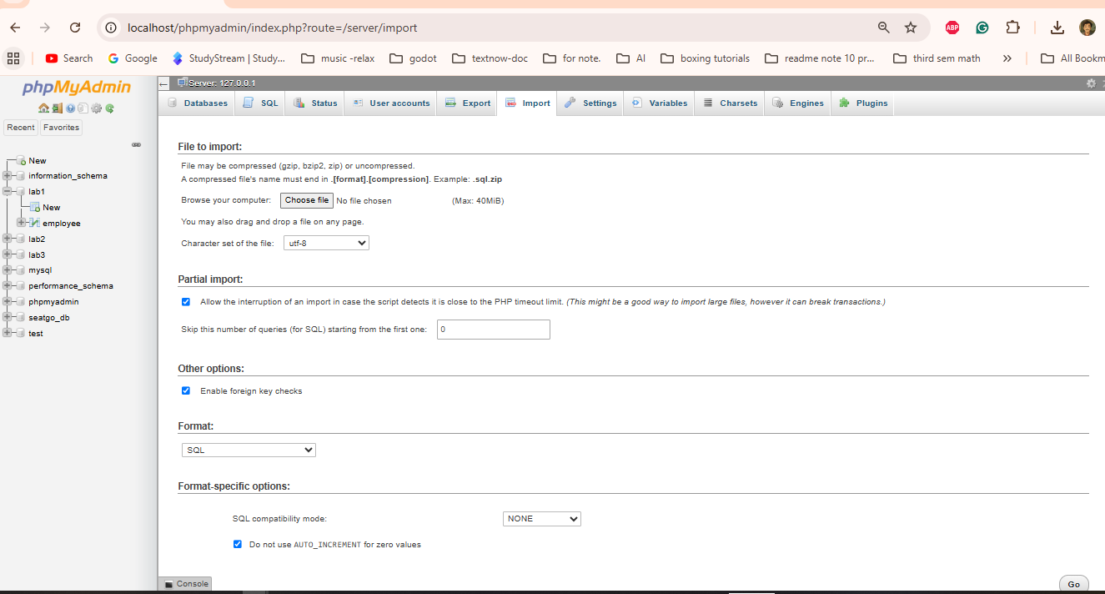
Restoring the Database (phMyAdmin Interface)

Slide 14
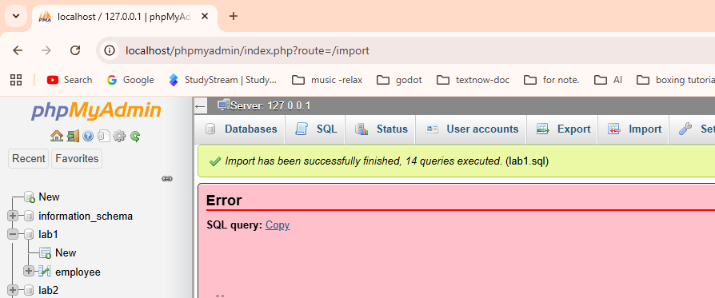
Restoring the Database (phMyAdmin Interface)

Slide 15
Restoring the Database
To restore the same data later:
mysql -u root -p school_db < school_backup.sql
Explanation:
Loads all tables and data back into the database.
Used after data loss or when transferring data to another server.
Dumping = Save it.
Restoring = Bring it back.

Slide 16
Thank You
Presented by:
Salim Shrestha
Saraswoti Rokaya

